Slide 1
SY26-27 Fall Enrollment Design Template Guidelines

Slide 2


What stayed the same
The refresh keeps last year's structure. Six things carry over:
1. Talent front & center: blue gradient overlay separates the background. Talent is never recolored.
2. Yellow corner flares: highlight the talent and pull yellow into the design.
3. Footer wave lockup: front + rear waves hold the logo, CTA, buttons, QR, URL, and phone.
4. Bold white messaging: left-justified, readable from a distance. Keywords in yellow.
5. Footers by channel: print: QR, CTA, URL, phone, logo. Digital: logo, CTA, button.
6. Secondary messaging: stays the same as last year.
SY25-26
SY26-27 Refresh

Slide 3
What changed
PREVIOUS · SY25-26
REFRESH · SY26-27
Black logo, bottom left.
Flat yellow footer wave.
Brush-stroke highlight on key phrases.
Yellow-led palette, ADA compliant with the black logo.
Full-color reverse 30th lockups, bottom center.
Gradient wave footer system (Linear / Radial Footer).
Clean headline treatment: no brush stroke.
Blue-led palette, keeps the full-color logo ADA compliant.
Why blue? The full-color logo contains yellow, so a yellow-led design can no longer pass ADA contrast. Blue leads, and yellow returns in the corner flares and footer gradients.

Slide 4


The footer system
1. Linear Footer (Footer 2)
Use first. The preferred primary footer.
2. Radial Footer (Footer 1)
Fallback. Most ADA-forgiving. Switch to it when readability needs it.
Gradient rules: amplify the yellow-to-blue gradients. Never over the logo or text, never muddy, never orange. Readability first.

Slide 5

Campaign logo rules
30TH ANNIVERSARY LOGO GUIDE
• Full-color reverse only: white + yellow. Never the blue & yellow version.
• Always the 30th anniversary lockup: logo locked up with the 30 Years of Impact badge.
• Always bottom center: of the footer, on every format.
• Never let it blend: the logo must always hold contrast against the background.
• Match the region: logo, URL, phone, and QR must all belong to the same school or region.

Slide 6
Template library: CMYK & RGB
PRINT · CMYK
DIGITAL · RGB
1:1
3:4
9:16
1:1
9:16
Square
Posters & flyers
Vertical signage
Social & display
Stories & reels
160×600
Landscape
1200×628
728×90
Banner ads
Billboards, bus ads & wide OOH
Link & feed ads
CMYK prints. RGB screens. Every format ships with every footer variant: the hierarchy applies in all sizes.

Slide 7

Print vs. digital footers
PRINT
QR · CTA · URL · phone · logo. Print carries its own response path. No buttons. A printed button can't be pressed.
DIGITAL
Logo · CTA · button. Digital clicks through to the linked URL, so no QR or URL is needed. The button invites the click: viewers often don't realize an ad is clickable.

Slide 8





Creative in use: Digital (RGB)
DOWNLOAD DIGITAL TEMPLATES
1200×628 link ad · Gold Wave
1:1 · Linear Footer
728×90 leaderboard · Blue Wave
Screen-ready: no QR or URL. Every unit clicks through, and the button invites it.
9:16 story · Gold Wave
160×600 skyscraper · Gold Wave

Slide 9
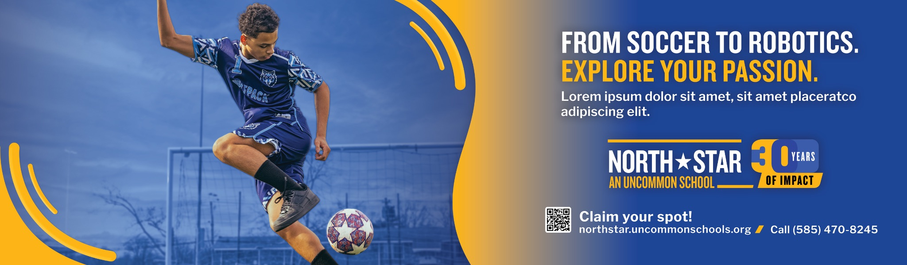



Creative in use: Print (CMYK)
DOWNLOAD PRINT TEMPLATES
Landscape OOH · Linear Footer
Spot the system: talent up front, flares up top, yellow key words, logo bottom-center over the gradient waves with QR, URL, and phone.
1:1 · Radial Footer
9:16 · Linear Footer
3:4 poster · Linear Footer

